Slide 1


Slide 2

Why, What and How Data Wrangling
Industry Overview and Business Applicability
Ashwini Kuntamukkala
Enterprise Architect @ Vizient, Inc
Twitter: @akuntamukkala
Notes:
This presentation demonstrates the new capabilities of PowerPoint and it is best viewed in Slide Show. These slides are designed to give you great ideas for the presentations you’ll create in PowerPoint 2011!
For more sample templates, click the File menu, and then click New From Template. Under Templates, click Presentations.

Slide 3
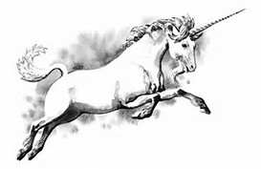
Goal: Better Faster Cheaper!
Better
Marketing
Campaign
Million (USD)
Insights
* Typical Business End Game
$$$
My data are 100% accurate but are they?

Slide 4
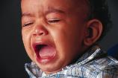
Vicious cycle
Bad Data
Incorrect Analysis
Invalid
Insights
Wrong Decisions
Poor Outcomes
Data Quality is an issue…

Slide 5
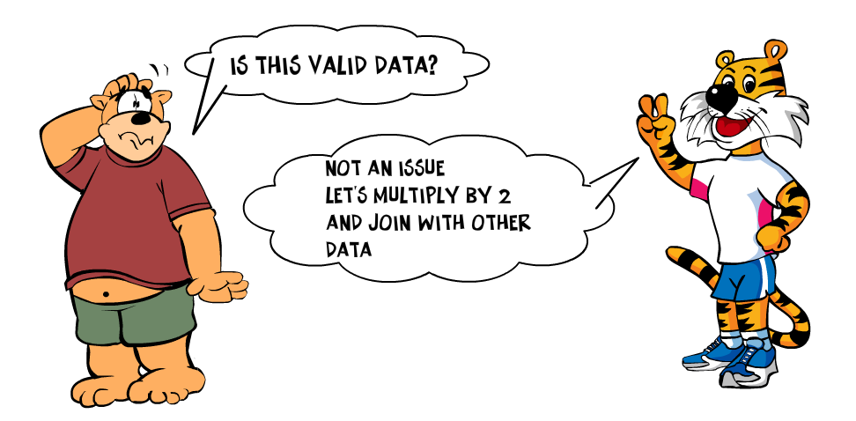
Data Quality Issue
Gartner Report
By 2017, 33% of the largest global companies will experience an information crisis due to their inability to adequately value, govern and trust their enterprise information.
Cartoon made using http://www.toondoo.com/
If you torture the data long enough, it will confess to anything – Darrell Huff

Slide 6
Gartner
https://www.gartner.com/en/about

Slide 7














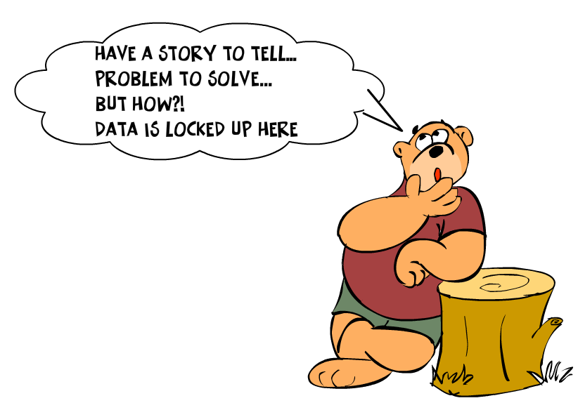



Noise to Signal?
DB
Machine
sensor
Data has a habit of replicating itself

Slide 8

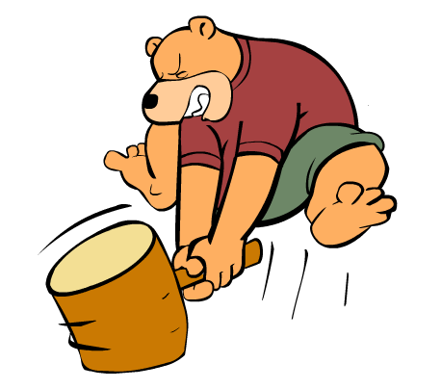
Data Wrangling is …
Process of transforming “raw” data into data that can be analyzed to generate valid actionable insights

Slide 9

Data Wrangling: aka…
Data Preprocessing
Data Preparation
Data Cleansing
Data Scrubbing
Data Munging
Data Transformation
Data Fold, Spindle, Mutilate…
noise
signal

Slide 10
Data Wrangling Steps
Obtain
Understand
Transform
Augment
Shape
Iterative process
Understand
Explore
Transform
Augment
Visualize
Share
An approximate answer to the right problem is worth a good deal more than an exact answer to an approximate problem. – John Tukey

Slide 11
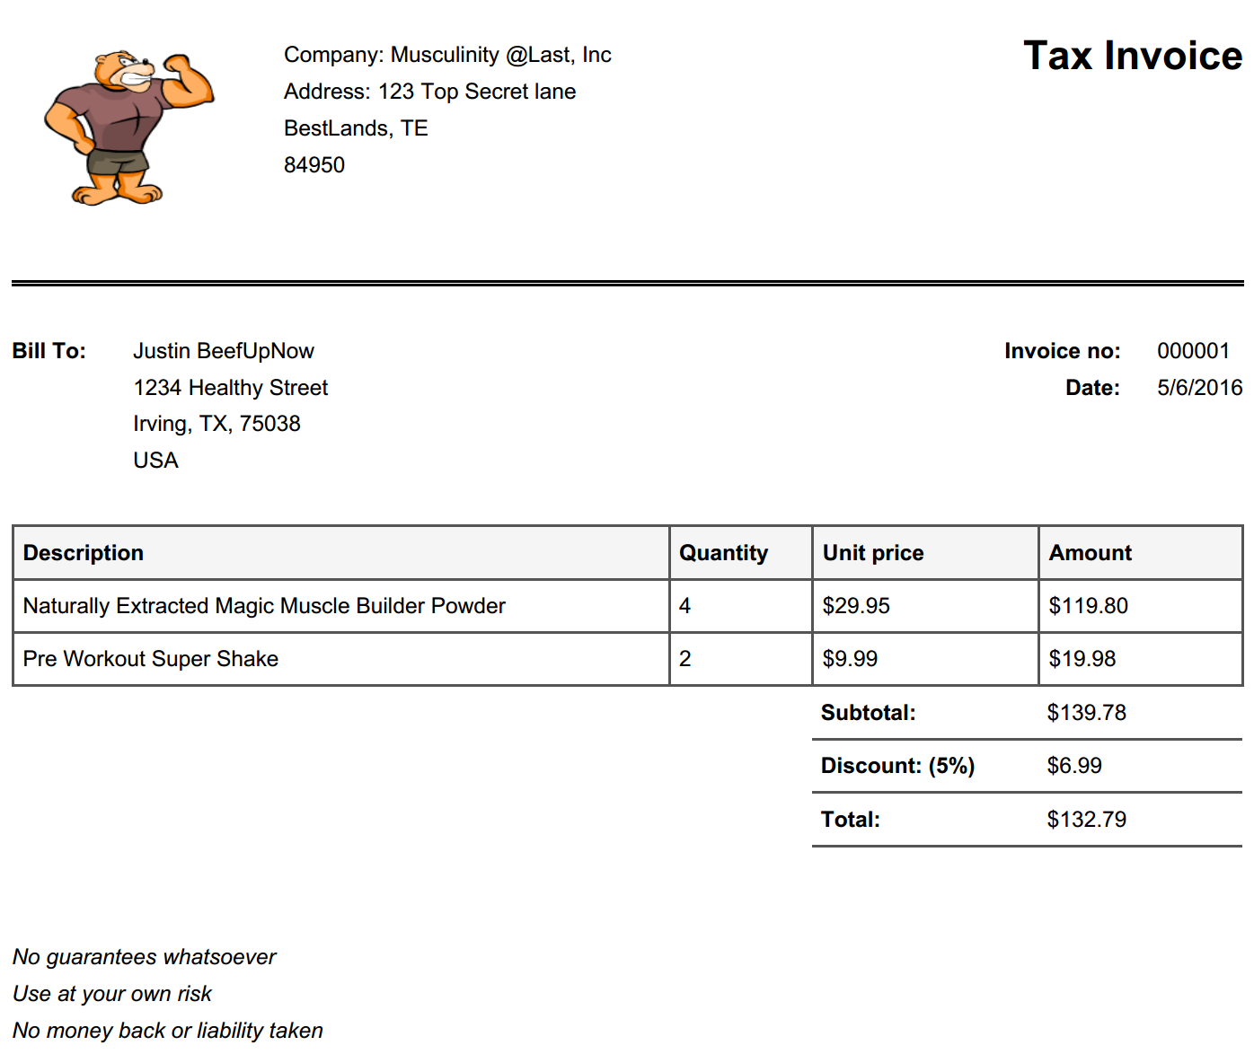


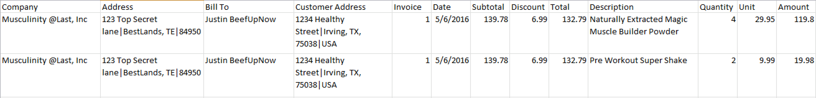
Let’s take a PDF Invoice…for example

Slide 12
Altair Monarch (Datawatch)
https://docs.datawatch.com/monarch/desktop/Introduction__The_Monarch_Application.htm

Slide 13
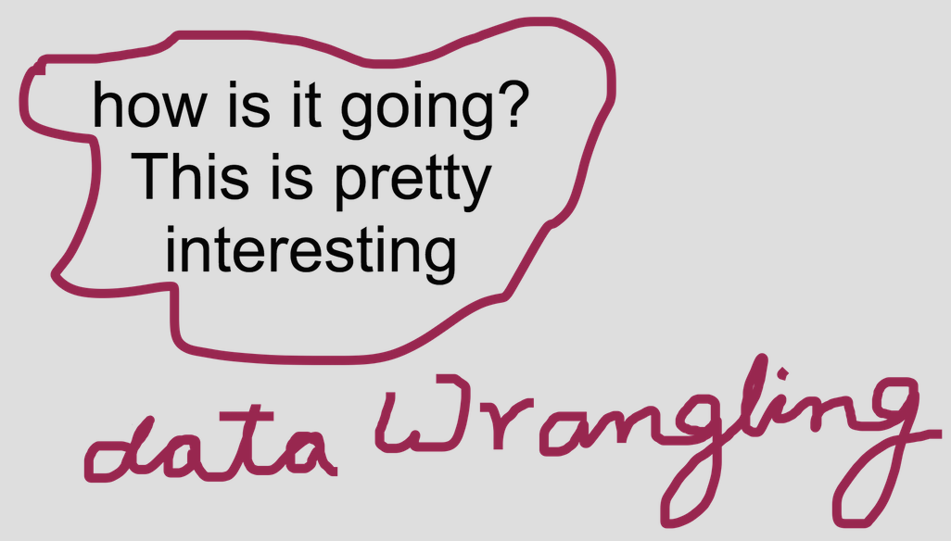
Let’s take an image…
Python + Textract +Tesseract

Slide 14



Understand your data
“Looks like my V8 Chevy is running low on fuel. Didn’t I fill up just the day before?”
Owner | Vehicle | Type | Fuel Level | Engine | Last Fill
AK | Chevy | Gas | 5% | V8 | 05/04/16
DALDFWSFOEWRBOSDCALAXORDJFKMCO
Or
DAL DFW SFO EWR BOS DCA LAX ORD JFK MCO

Slide 15

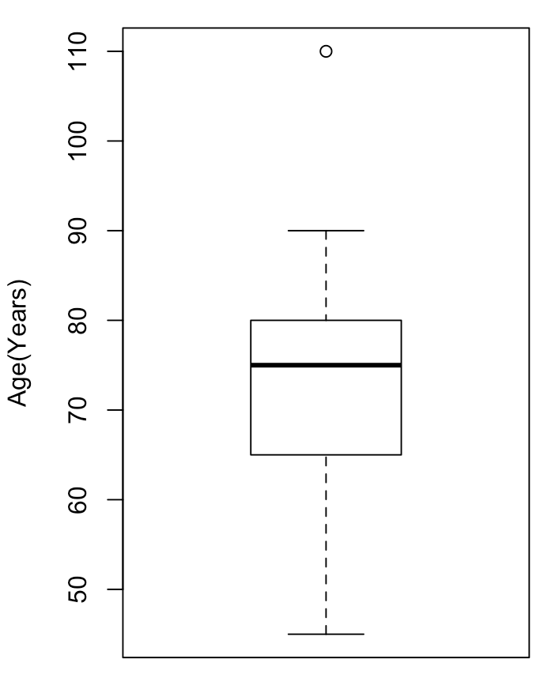

Outliers
???
75
80
65
55
67
78
88
90
45
58
69
80
110
Age(Years)
75
80
65
55
67
78
88
90
45
58
69
80
110

Slide 16

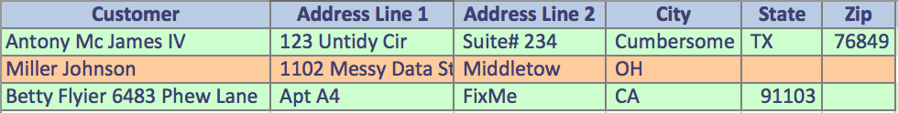

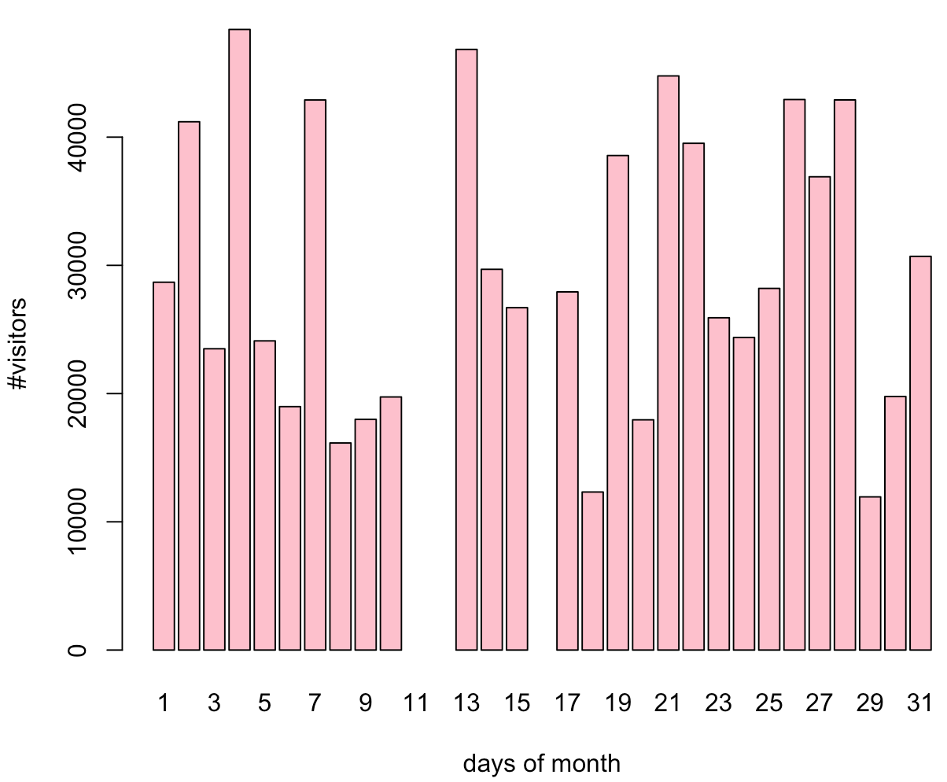
Missing Values
Missing with a bias
Missing due to invalid data and ingestion
Missing @ Random
Missing completely
Missing due to inapplicability

Slide 17

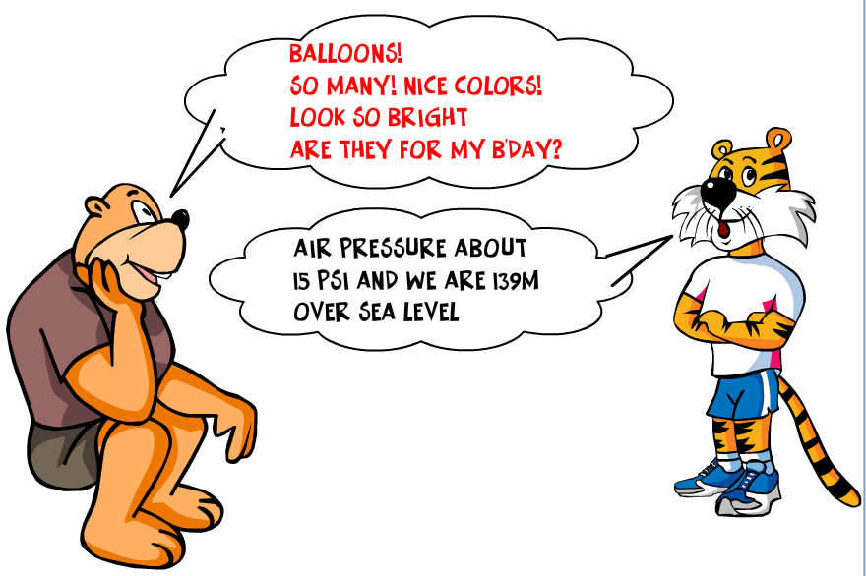
Types of data
Qualitative
Subjective
Quantitative
Discrete
Continuous
Categorical

Slide 18

Data Source Selection Criteria
Credible
Complete
Verifiable
Accurate
Current
Compliance
Accessible
Cost
Legal
Security
Storage
Provenance

Slide 19
Tidy Data: Not all tables are created equal
Column
year
School | 2012 | 2013 | 2014
Good Samaritans | 2321 | 4550 | 1293
Percy Grammar | 1540 | 1400 | 2949
Row
Variable
School | Year | Student Count
Good Samaritans | 2012 | 2321
Good Samaritans | 2013 | 4550
Good Samaritans | 2014 | 1293
Percy Grammar | 2012 | 1540
Percy Grammar | 2013 | 1400
Percy Grammar | 2014 | 2949
Observation

Slide 20
Tidy Data: Not all tables are created equal
Year | Comedy-Q1 | Thriller-Q1 | Action-Q1 | …
2014 | 2 | 1 | 0
2015 | 0 | 3 | 2
Find total comedy movies in all of 2014? -> Not easy in current form
Category | Quarter | Year | #Hits
Comedy | Q1 | 2014 | 2
Thriller | Q1 | 2014 | 1
Action | Q1 | 2014 | 0
Comedy | Q1 | 2015 | 0
Thriller | Q1 | 2015 | 3
Action | Q1 | 2015 | 2
Find % of hit comedy movies in a 2015?
Very easy to add a new column

Slide 21
Tidy Data: Not all tables are created equal
Category | Rating | Q1 | Q2 | Q3 | …
Comedy | Excellent | 1 | 0 | 1
Comedy | Good | 2 | 0 | 2
Thriller | Excellent | 0 | 1 | 1
Thriller | Good | 1 | 0 | 3
Category | Quarter | Excellent | Good
Comedy | Q1 | 1 | 2
Comedy | Q2 | 0 | 0
Comedy | Q3 | 1 | 2
Thriller | Q1 | 0 | 1
Thriller | Q2 | 1 | 0
Thriller | Q3 | 1 | 3
Very messy data
Variables in both rows and columns
Each row is complete
observation

Slide 22
Tidy Data: Not all tables are created equal
Invoice | Bill To | Sales % | Total($) | SKU# | Item | Qty | Unit Price ($)
1 | Jim Jones | 8 | 8.03 | A123 | Hammer | 1 | 3.55
1 | Jim Jones | 8 | 8.03 | Q34 | Screw Driver | 2 | 2.05
2 | Mike Z’Kale | 8 | 97.20 | W23 | Hair Dryer | 1 | 59.25
2 | Mike Z’Kale | 8 | 97.20 | E452 | Cologne | 3 | 10.25
Normalize to avoid duplication
Invoice | Bill To | Sales % | Total($)
1 | Jim Jones | 8 | 8.03
2 | Mike Z’Kale | 8 | 97.20
Invoice | SKU# | Item | Qty | Unit Price ($)
1 | A123 | Hammer | 1 | 3.55
1 | Q34 | Screw Driver | 2 | 2.05
2 | W23 | Hair Dryer | 1 | 59.25
2 | E452 | Cologne | 3 | 10.25

Slide 23
Tidy Data: Not all tables are created equal
Category | Quarter | Year | #Hits
Comedy | Q1 | 2014 | 2
Thriller | Q1 | 2014 | 1
Action | Q1 | 2014 | 0
Category | Quarter | Year | #Hits
Comedy | Q1 | 2014 | 2
Thriller | Q1 | 2014 | 1
Action | Q1 | 2014 | 0
Category | Quarter | Year | #Hits
Comedy | Q1 | 2014 | 2
Thriller | Q1 | 2014 | 1
Action | Q1 | 2014 | 0
Multiple Tables
Divided by Time
Category | Quarter | Year | #Hits
Comedy | Q1 | 2014 | 2
Thriller | Q1 | 2014 | 1
Action | Q1 | 2014 | 0
Comedy | Q1 | 2014 | 2
Thriller | Q1 | 2014 | 1
Action | Q1 | 2014 | 0
Combine all tables
accommodating
varying formats

Slide 24



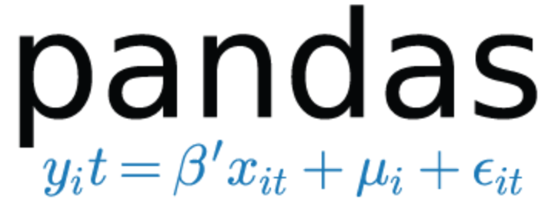


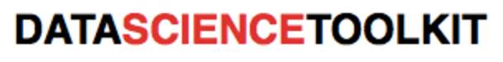
Popular Open Source Options

Slide 25



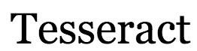




http://schoolofdata.org/
http://okfnlabs.org/

Slide 26








Commercial Vendors

Slide 27
Hands on Data Wrangling
Data Ingestion
CSV
PDF
API/JSON
HTML Web Scraping
Data Exploration
Visual inspection
Graphing
Data Shaping
Tidying Data
Data Cleansing
Missing values
Format
Outliers
Fat Fingered Data
Data Augmenting
Aggregate data sources

Slide 28
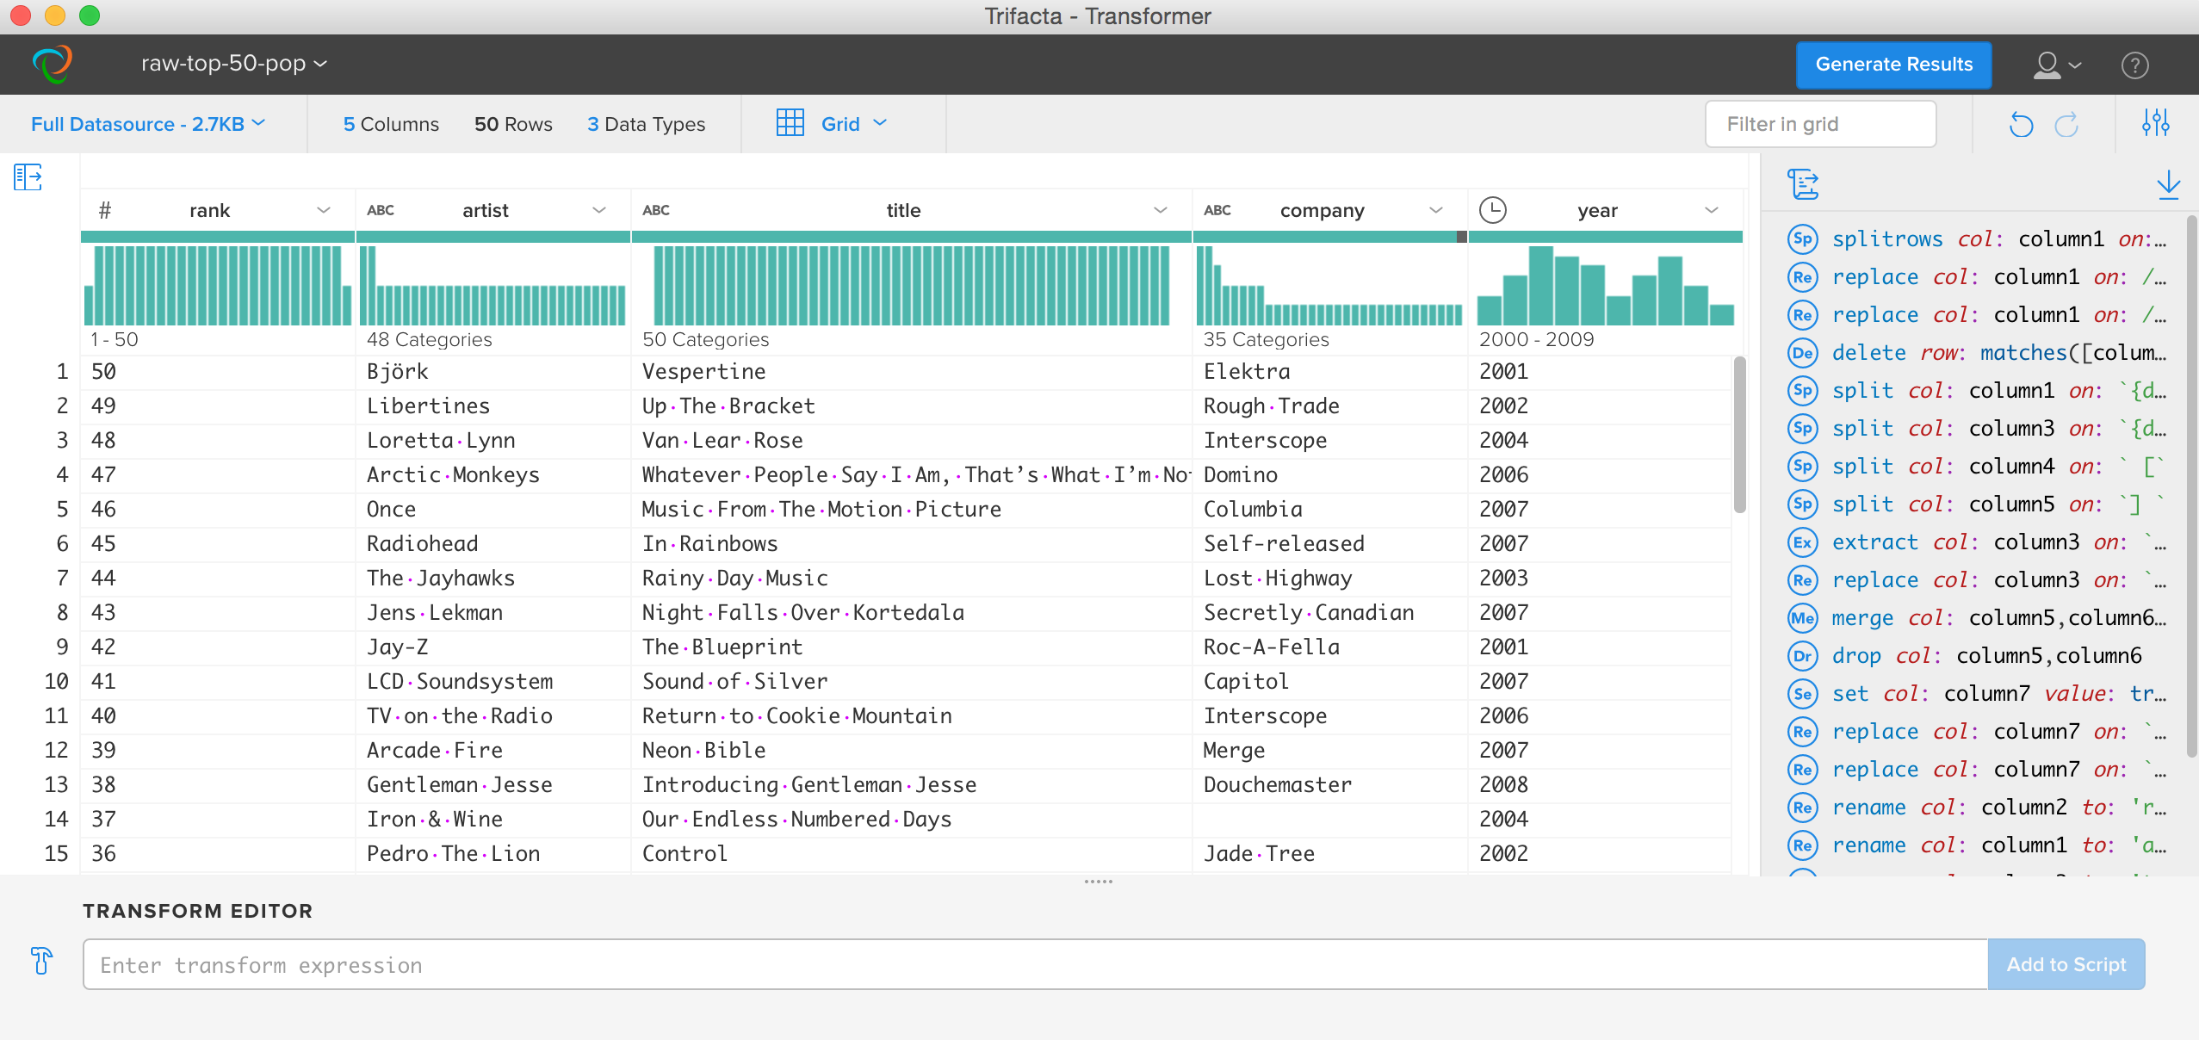
Trifacta Wrangler

Slide 29
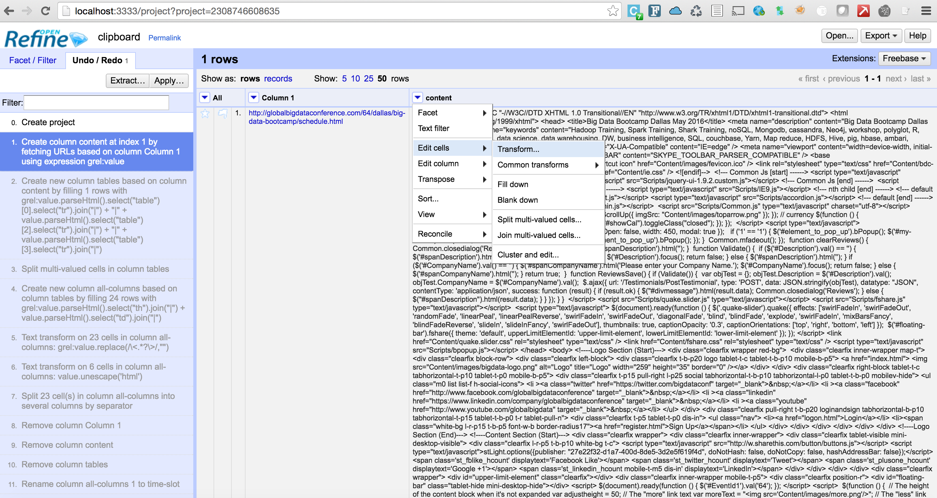
Google’s Open Refine

Slide 30
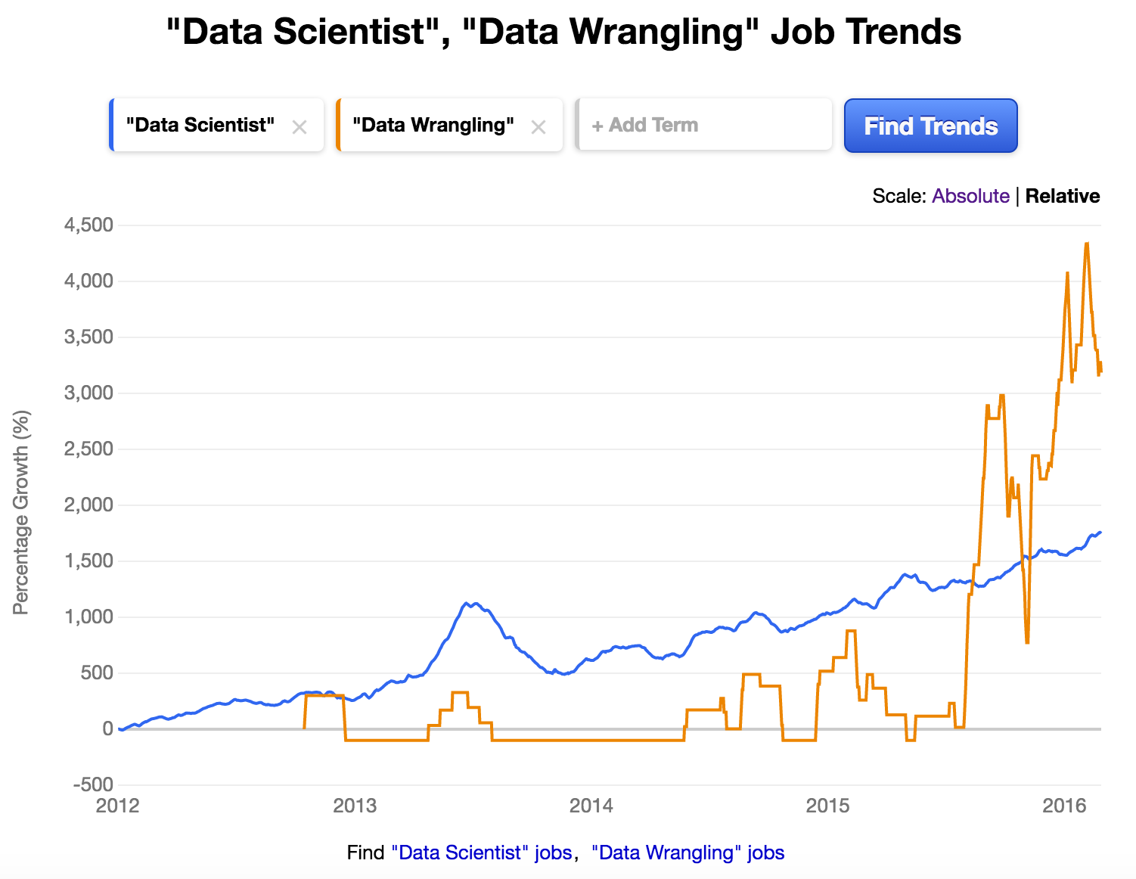
Why should you care?
Better Outcomes
Tooling Innovation
Increased Productivity
Ease of use
Lessened skill gap
Great skill to have per Indeed.com ☺

Slide 31

Questions
Thank you for your participation

